Slide 1
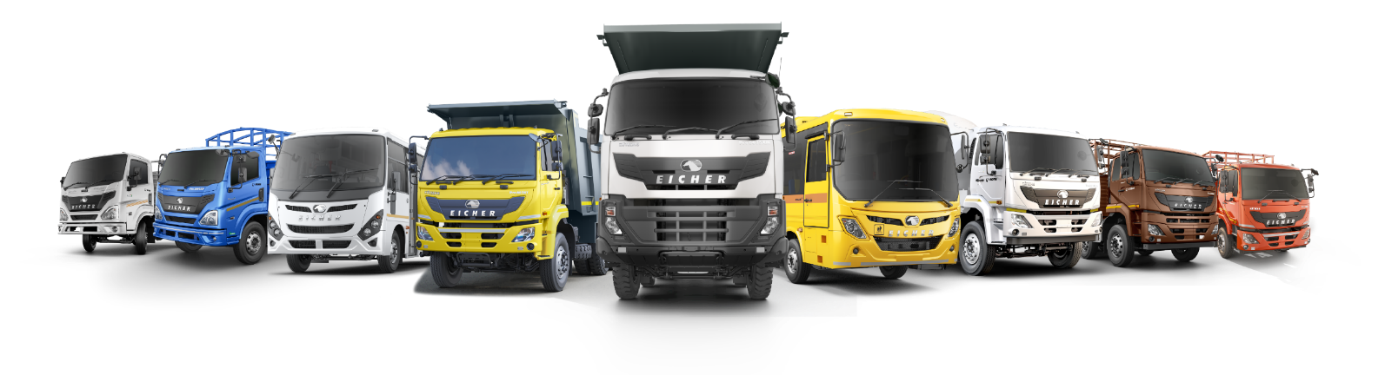
Weekly Production Review
1st Sep 2026

Slide 2

Let’s Value Our Values
Passion
At VECV, we take pride in our work and are committed to going above and beyond for our customers. Our passion drives us to consistently exceed our stakeholders' expectations.
Excellence
At VECV, we pride ourselves on providing high-quality results and exceeding ambitious targets. We are continually challenging ourselves to innovate for the future and work tirelessly to establish new benchmarks for meeting and exceeding consumer expectations.
Respect
Respect for all stakeholders is a key belief at VECV, which drives us to deliver on our promises and hold ourselves accountable to all obligations in an enabling atmosphere that recognizes, embraces, and celebrates diversity.
Fair & Ethical
Our goal at VECV is to establish and maintain a strong reputation over time. We endeavor to run our business with integrity, treat everyone fairly, and be reasonable and ethical in all of our dealings.
Customer Centric
The customer's point of view is central to our organizational process, and with a proactive focus on his/her changing needs, coupled with consistently excellent service, at VECV we aim to create a mutually beneficial long term relationship with our customers.

Slide 3
CODE OF
CONDUCT
In our interaction with Employees and all those who work with us
I will….
Treat everyone with respect. I will avoid any behavior that could reasonably be seen as offensive or inappropriate.
Always engage professionally with coworkers, supervisors, subordinates, and staff of service providers, regardless of differences in opinion, role, or background.
Provide equal opportunity to all, regardless of gender, race, religion, caste, color or age.
Maintain honest, transparent, and open communication.
Object to harassment or other inappropriate conduct, whether directed at me or someone else.
Report any potential conflict of interest to my manager
Be completely aware of and adhere to the Policy for the Prevention of Sexual Harassment at the Workplace.
Take responsibility for my own safety and the safety of those around.
I will report any unsafe actions and make sure to understand and obey all safety rules
I will not….
Bully, intimidate, harass or threaten another person
Disclose or share confidential information about the company with unauthorized individuals or on social media.
Discuss confidential information in public places or leave confidential material unattended, even within the office.
Accept undue favors that could be considered a bribe, or unlawful gifts and entertainment.
Engage in any financial transactions with other employees or those who work with me.
gossip, spread rumors, or engage in any behavior that is hostile, demeaning, or disruptive at work.
Present inaccurate information
Make anyone wait when they arrive for their scheduled appointment with me.

Slide 4
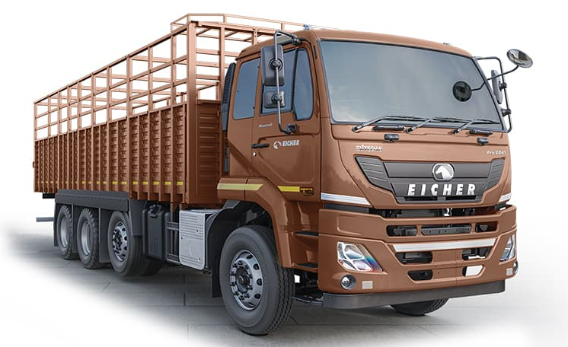
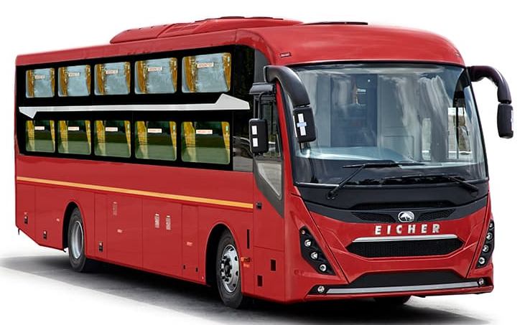
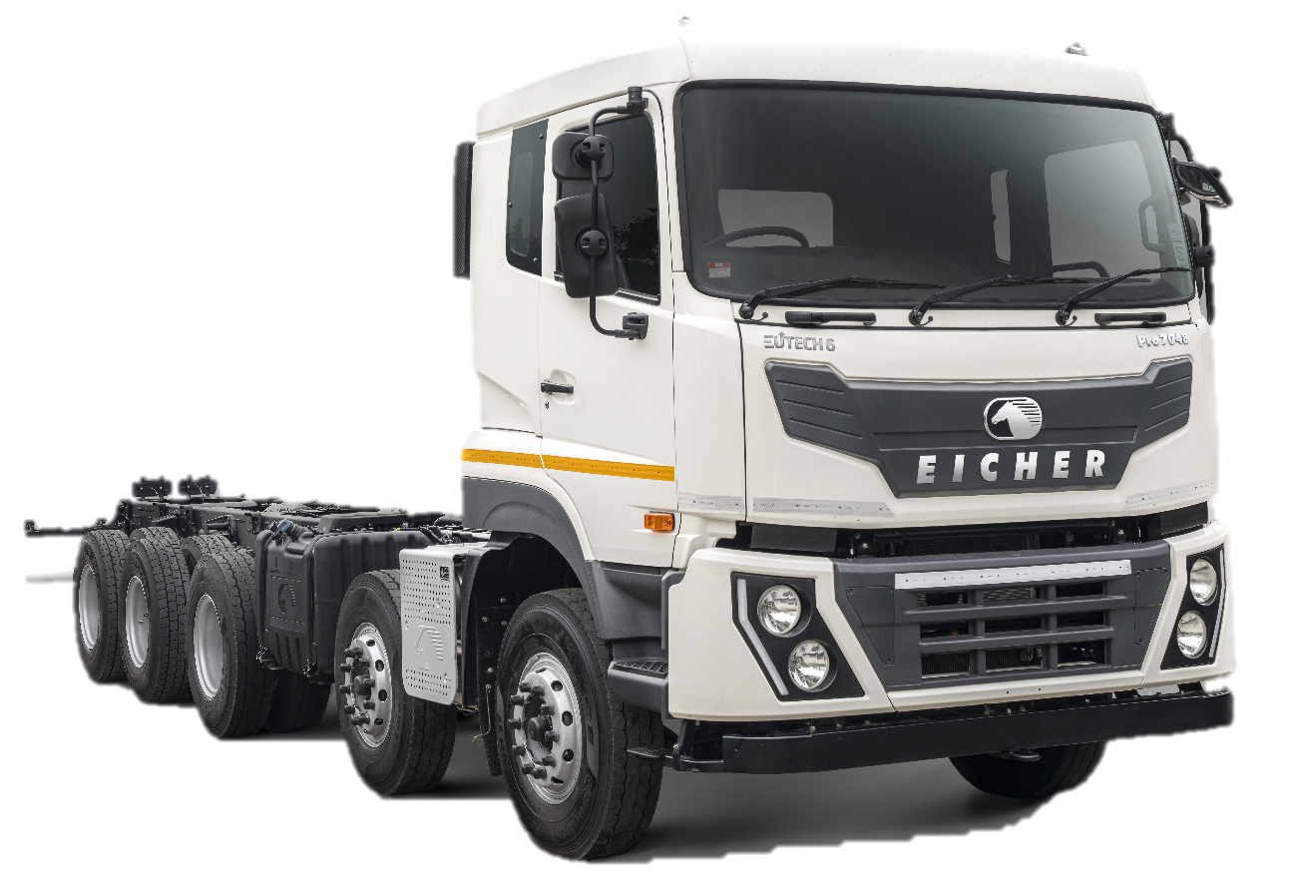
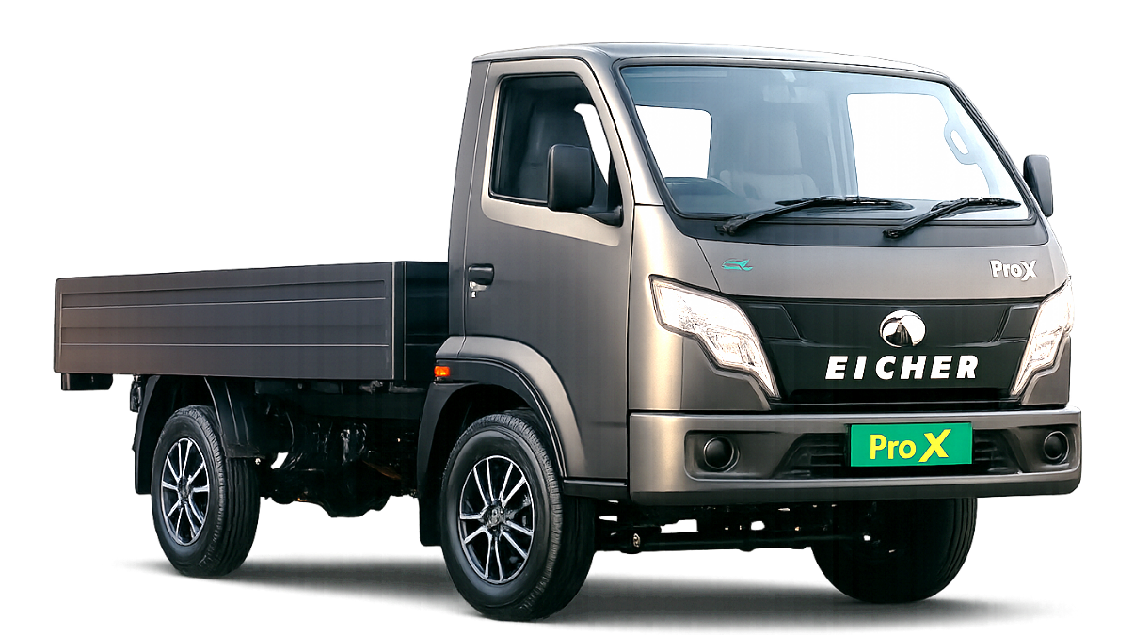
Our Focus – Pro X, Pro 6000 & Pro 7000 Platforms

Slide 5
Likely Opening FG 1st Sep
Opening Saleable FG as on 1st Sep –9807 as against 8793 on 1st Aug 26
Opening WIP + RGP as on 1st Sep – 1140as against 1833 on 1st Aug 26
Month | Opening FG | Total | Exports | LD Trucks | HD Trucks | Buses | Pro X
Aug-26 | Saleable Opening FG 1st Aug | 8793 | 509 | 3052 | 2841 | 2123 | 268
 | WIP | 716 | 55 | 331 | 118 | 18 | 194
 | RGP WIP | 1117 | 231 | 85 | 215 | 575 | 11
 | Total WIP+RGP | 1833 | 286 | 416 | 333 | 593 | 205
 | Grand Total (FG+WIP+RGP) | 10626 | 795 | 3468 | 3174 | 2716 | 473
Aug-26 | Delivery | 9176 | 576 | 4614 | 2187 | 846 | 953
 | Sales | 8162 | 578 | 4057 | 1960 | 1001 | 566
1st Sep 26 | Likely Saleable Opening FG 1st Sep | 9807 | 507 | 3609 | 3068 | 1968 | 655
 | WIP | 227 | 29 | 50 | 106 | 15 | 27
 | RGP WIP | 913 | 257 | 31 | 107 | 506 | 12
 | Total WIP+RGP | 1140 | 286 | 81 | 213 | 521 | 39
 | Grand Total (FG+WIP+RGP) | 10947 | 793 | 3690 | 3281 | 2489 | 694

Slide 6
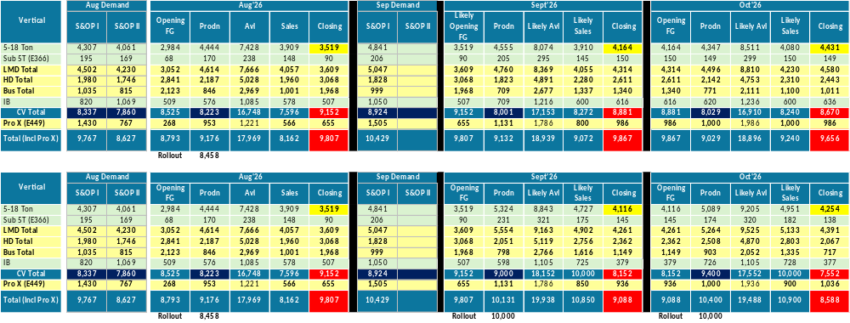
Simulation based on Sales demand & sale indication……..
Scenario 1 – Based on Sales Demand, Projection & Commitment
Scenario 2 – 10K Production & 10K Sale in Sep/Oct

Slide 7
Rollout Comparison FY’26 vs FY’27
Rollout 24% & Sales 15% up than last year
Rollout Comparision FY'26 vs FY'27
FY'26 | Rollout | Cum | Sales | Cum | Opng FG | Opng WIP+RGP |  | FY'27 | Rollout | Cum | Sales | Cum | Opng FG | Opng WIP+RGP
Apr-25 | 9523 | 9523 | 6717 | 6717 | 5182 | 907 |  | Apr-26 | 8254 | 8254 | 7159 | 7159 | 6444 | 938
May-25 | 8024 | 17547 | 7258 | 13975 | 7763 | 1198 |  | May-26 | 8631 | 16885 | 7789 | 14948 | 7751 | 743
Jun-25 | 6539 | 24086 | 7198 | 21173 | 8966 | 753 |  | Jun-26 | 8722 | 25607 | 9269 | 24217 | 8194 | 1061
Jul-25 | 5652 | 29738 | 6940 | 28113 | 8075 | 810 |  | Jul-26 | 10033 | 35640 | 8045 | 32262 | 7305 | 1418
Aug-25 | 5852 | 35590 | 6924 | 35037 | 6814 | 792 |  | Aug-26 | 8458 | 44098 | 8162 | 40424 | 9012 | 1719
Sep-25 | 7338 | 42928 | 7352 | 42389 | 5748 | 712 |  | Sep-26 |  |  |  |  | 9807 | 1140
Oct-25 | 7003 | 49931 | 7771 | 50160 | 5668 | 869 |  | Oct-26
Nov-25 | 7911 | 57842 | 7425 | 57585 | 5079 | 747 |  | Nov-26
Dec-25 | 10657 | 68499 | 10177 | 67762 | 5037 | 1242 |  | Dec-26
Jan-26 | 11463 | 79962 | 10430 | 78192 | 5628 | 1150 |  | Jan-27
Feb-26 | 10992 | 90954 | 9766 | 87958 | 6438 | 1391 |  | Feb-27
Mar-26 | 11498 | 102452 | 13113 | 101071 | 7906 | 896 |  | Mar-27
Total | 102452 |  | 101071 |  |  |  |  | Total | 44098 | 24% | 40424 | 15%

Slide 8
BP vs Actual
Rollout 4.4% up than BP
Month | Business Plan |  |  |  | Actual
 | LMD | HD | Pro X | Total | Rollout | Delivery | Sale
Apr-26 | 5251 | 1862 | 771 | 7884 | 8254 | 8462 | 7159
May-26 | 5619 | 1960 | 840 | 8419 | 8631 | 8338 | 7789
Jun-26 | 5724 | 2086 | 939 | 8749 | 8722 | 8390 | 9269
Jul-26 | 5800 | 2150 | 865 | 8815 | 10033 | 9752 | 8045
Aug-26 | 5368 | 2141 | 880 | 8389 | 8458 | 9176 | 8162
Sep-26 | 5473 | 2218 | 990 | 8681
Oct-26 | 5690 | 2395 | 1160 | 9245
Nov-26 | 5440 | 2350 | 1075 | 8865
Dec-26 | 6216 | 2583 | 1120 | 9919
Jan-27 | 6790 | 2794 | 1195 | 10779
Feb-27 | 6961 | 2821 | 1110 | 10892
Mar-27 | 7968 | 3010 | 1355 | 12333
Grand Total | 72300 | 28370 | 12300 | 112970 | 44098 | 44118 | 40424
YTD % |  |  |  |  | 4.4% | 4.4% | -4.3%
YTD BP |  |  |  |  | 42256 | 42256 | 42256

Slide 9
Actuals Volume (Sep’26)
Highlights:-
  YTD rollout till Aug 44098 in FY’27, 24% up w.r.t. 35590 in FY’26.
  Highest ever CV Rollout in any Aug 8458 earlier 5852 in Aug-25.
  Highest ever Pro X Rollout 777 earlier 755 in July-26.
  CKD Delivered 100 nos
  IS Buses Delivery enhanced (Kerela Police & Others) 27 to 60
  Rush orders delivery 300+
Rollout Actual — 8458 (CV 7681 + Pro X – 777),
Delivery Actual – 9176 (CV 8223 + Pro X - 953),
Aug-26 | S&OP II demand | S&OP II Commitment 8th |  | Actual
Line | 3rd July | Rollout | Delivery | Rollout | Delivery | WIP
CV | 7859 | 8866 | 8001 | 7681 | 8223 | 200
Pro X | 1418 | 1108 | 1187 | 777 | 953 | 27
Total | 9277 | 9974 | 9188 | 8458 | 9176 | 227
Exports:
EPS:
Engines – Sales Demand 586/Commitment 614/Delivery Actual – 595)
Axles— Sales Demand 134/Commitment 134/Delivery Actual – 132)
IS:
Commitment- 27, Actual – 60
 | Commitment 8th |  |  | Actual
 | Total | Truck | Buses | Total | Truck | Buses
Delivery by 30th | 630 | 405 | 225 | 576 | 393 | 183
Billable by 30th | 496 | 363 | 133 | 527 | 391 | 136
Pro X
Models | Demand S&OP II | Commitment 8th |  | MTD Actuals
 |  | Rollout | Delivery | Rollout | Delivery | WIP
Pro X DSL | 1146 | 915 | 1015 | 763 | 936 | 17
Pro X CNG | 65 | 65 | 66 |  | 2
Pro X EV | 207 | 128 | 106 | 14 | 15 | 10
Pro X Total | 1418 | 1108 | 1187 | 777 | 953 | 27
Buses:
Bus plant demand – 1118 / Commitment – 625 / Actual - 671
Domestic bus demand 295/ Commitment- 377 / Actual- 425
Audi demand - 5/ Commitment- 61/ Actual - 55
Exports – 580 Demand / Commitment- 215 / Actual- 183
Market Cowl
Commitment 517, Actual 651

Slide 10
Aug’26 ..S&OP demand Commitment & Actuals-Summary
Category | S&OP-1 | S&OP-2 | S&OP-2 Delivery Commitment | EMT 25th Outlook-Delivery | Actual Delivery | Actual Rollout |  | Remarks
 | Demand | Demand
LMD Trucks | 4475 | 4192 | 4526 | 4626 | 4600 | 4268
HD Trucks | 1861 | 1631 | 1924 | 2023 | 2083 | 1948
HD Mkt Cowl | 75 | 85 | 88 | 82 | 75 | 75
LMD Mkt Cowl | 291 | 167 | 209 | 220 | 215 | 209
DOM Bus Plant | 337 | 310 | 389 | 425 | 428 | 337
Audi | 62 | 0 | 61 | 61 | 55 | 10
JCBL | 8 | 0 | 7 | 7 | 7 | 0
Exp Bus Plant | 517 | 591 | 225 | 181 | 183 | 211
Exports Trucks | 303 | 477 | 406 | 405 | 393 | 370
IS- Buses | 219 | 224 | 21 | 21 | 48 | 132
IS Trucks | 6 | 11 | 6 | 6 | 12 | 6
NPI | 184 | 171 | 153 | 153 | 117 | 108
Grand Total | 8338 | 7859 | 8015 | 8210 | 8216 | 7674
Pro X
Rollout Commitment-1100/Actual- 777
Delivery Commitment -1163/Actual -939
Pro X | Engine/Battery | Demand | Commitment | Actual Delivery | Remarks
 |  | (For Sales)
10.8ft (XL) | DSL | 371 | 366 | 361 | 10- NPI Project- delayed rollout
 | CNG | 16 | 16 | 0 | Frame short
 | Total | 387 | 382 | 361
9.8ft (XS) | DSL | 233 | 233 | 233
 | CNG | 16 | 16 | 0 | Frame short
 | Total | 249 | 249 | 233
Pro X EV | EV- 32KW- MR | 46 | 40 | 0 | Frame short
 | EV-40KW-LR | 86 | 55 | 1 | Frame short
 | Total | 132 | 95 | 1
Grand Total |  | 768 | 726 | 595

Slide 11
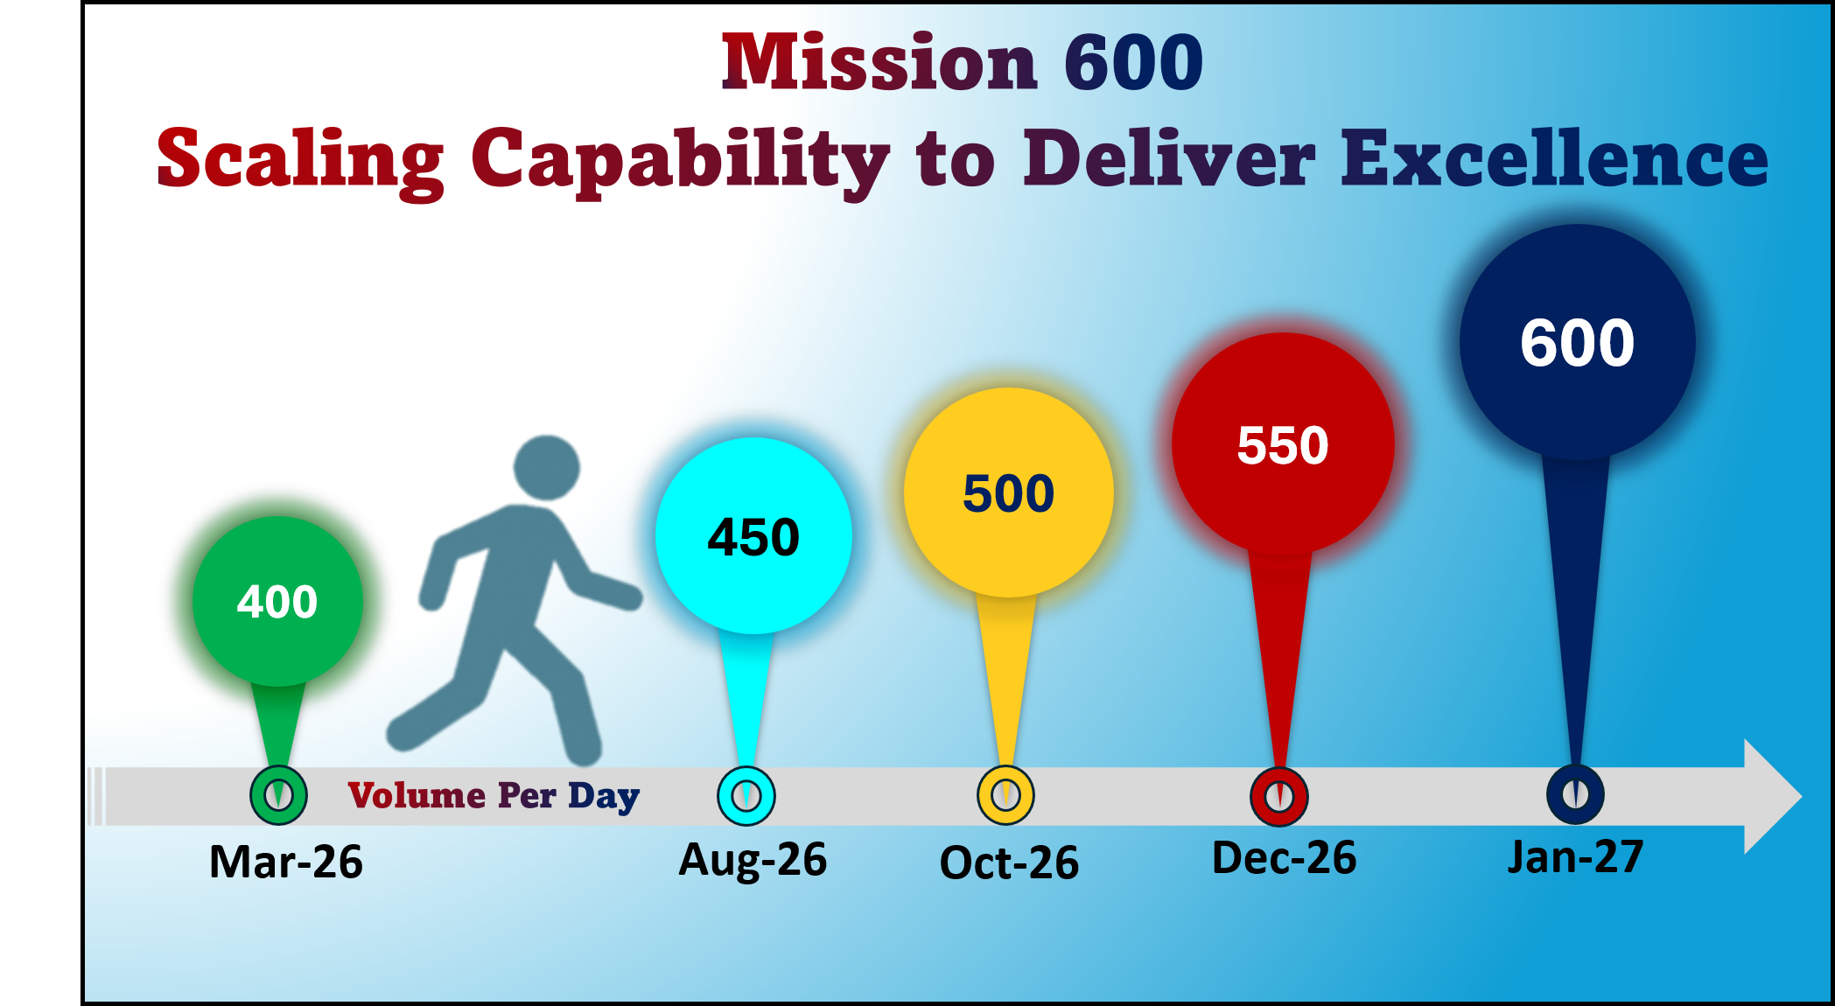

Slide 12
Volume – FY’27…Roadmap Sep-26 to Dec-26……..
Month | Days | Shift | 1 | 2 | 3 | 4 | 5 | 6 | 7 | 8 | 9 | 10 | 11 | 12 | 13 | 14 | 15 | 16 | 17 | 18 | 19 | 20 | 21 | 22 | 23 | 24 | 25 | 26 | 27 | 28 | 29 | 30 | 31 | Total
Sep-26 | 25 | 3-3-3 | 400 | 400 | 400 |  | 400 |  | 400 | 400 | 400 | 400 | 400 | 400 |  | 400 | 400 | 400 | 400 | 400 | 400 |  | 400 | 400 | 400 | 400 | 400 | 400 |  | 400 | 400 | 285 |  | 9885
Oct-26 | 25 | 3-3-3 | 435 |  | 435 |  | 435 | 435 | 435 | 435 | 435 | 435 |  | 435 | 435 | 435 | 435 | 435 | 435 |  | 435 |  | 435 | 435 | 435 | 435 |  | 435 | 435 | 435 | 435 | 435 | 285 | 10725
Nov-26 | 22 | 3-3-3 |  | 435 | 435 | 435 | 435 | 435 | DI | WA | LI |  | 355 | 355 | 355 | 355 |  | 435 | 435 | 435 | 435 | 435 | 435 |  | 435 | 435 | 435 | 435 | 435 | 435 |  | 285 |  | 9100
Dec-26 | 27 | 3-3-3 | 435 | 435 | 435 | 435 | 435 |  | 435 | 435 | 435 | 435 | 435 | 435 |  | 435 | 435 | 435 | 435 | 435 | 435 |  | 435 | 435 | 435 | 435 | 435 | 435 |  | 435 | 435 | 435 | 285 | 11595
Month | Aug-26 | Sep-26 | Oct-26 | Nov-26 | Dec-26 | Jan-27 | Feb-27 | Mar-27
Holidays | Independence day (15th) Raksha Bandhan (28th) | Janmashtami (04th) | Gandhi Jayanti (02nd) Dusshera (20th) | Diwali (7th to 10th) |  | Republic Day (26th) |  | Holi (22nd)
Day | Saturday Friday | Friday | Friday Tuesday | Saturday to Tuesday |  | Tuesday
Challenges
Suppliers impacting under close monitoring –
  Current rate – 325/Day………...
  JBM (cabin parts), Baxy, EECD, RKFL
  ZF parts,(Compressor & Stg GB) Jai Hind, Tata Toyo,
Pro X … ..Frame, AC Parts, Cabin. RA Shaft , Model changeover setting time for frame –impacting Stocking
Machine shop capacity at stretch (Being managed thru Sunday Operation)..Cyl block, Head
Manpower availability/ Festive month
Belmaks Cargo Body rate to gear up( Current need-100/Day)
Yard & Line Congestion situation at Pithampur & Bhopal
Yard for Pro X Stocking

Slide 13
VEPT Delivery
Aug’26 outlook is 4644 against a demand of 3740.
LYTD | YTD |  |  | Customers | Aug’26 |  |  | Sep'26 |  |  | Oct'26 |  |  | BP'27 | Outlook'27
 | BP | Demand | Actual |  | BP | Demand | Outlook | BP | Demand | Outlook | BP | Demand | Outlook
7,922 | 7,086 | 7,497 | 7,933 | Long Block (Nos.) | 2,288 | 1,548 | 2,248 | 2,058 | 2,732 | 2,856 | 2,143 | 922 | 1,762 | 23,428 | 25,797
4,584 | 5,393 | 3,918 | 4,077 | Engine Assembly (Nos.) - Volvo | 1,369 | 914 | 1,054 | 1,290 | 658 | 696 | 966 | 354 | 544 | 15,040 | 12,278
2,016 | 1,788 | 2,069 | 2,254 | Engine Assembly (Nos.) - Isuzu | 434 | 508 | 572 | 586 | 707 | 739 | 357 | 855 | 981 | 5,175 | 6,941
3,655 | 4,001 | 3,785 | 3,785 | Engine Assembly (Nos.) - Eicher | 1,117 | 770 | 770 | 1,180 | 860 | 860 | 1,346 | 1,131 | 1,131 | 15,533 | 13,607
18,177 | 18,268 | 17,269 | 18,049 | TOTAL | 5,208 | 3,740 | 4,644 | 5,113 | 4,957 | 5,151 | 4,812 | 3,262 | 4,418 | 59,175 | 58,624
Highlights YTD’27 & FY’27 (BP Vs. Outlook)
FY’25 Act. | FY’26 Act. | Customer​ | BP FY’27 | Outlook’27 | BP FY'28
28333 | 27988 | Venissieux​ | 23428 | 25797 | 22265
11545 | 12193 | ETB - VECV​ | 14828 | 12838 | 16678
10429 | 7625 | Curitiba​ | 9606 | 8406 | 10397
2166 | 3857 | PENTA VE & GE​ | 4609 | 2650 | 5192
5088 | 5260 | UDT Isuzu | 3584 | 5234 | 3304
1332 | 1620 | UDT Japan​ | 1590 | 1707 | 1248
634 | 736 | Volvo Bus | 705 | 769 | 798
628 | 1021 | VCE​ | 825 | 1223 | 928
60155 | 60300 | Total​ | 59175 | 58624 | 60809
YTD Actual w.r.t BP : 18268 against 18049
FY’27 Outlook w.r.t BP : 58624 against 59175
Growth
Customer | No.
VNX | 847
UDT Isuzu | 466
VCE | 138
VBI | 16
Reduction
Customer | No.
Curitiba | 568
Penta | 886
Eicher | 232
Growth
Customer | No.
VNX | 2369
UDT Isuzu | 1767
VCE | 397
VBI | 64
Reduction
Customer | No.
Penta | 1959
Curitiba | 1200
Eicher | 1990
13

Slide 14
Minutes of Meeting
Sno. | Discussion | Key Points | Update | Current Sttaus | Responsible
 | Date
1 | 4th Aug/25th | 20.15 STS Bus order 100 in Aug | Seat supplier approved from pinnacle…Supply challenge 2~3/day from 10th Sep onwards. | Chassis Opening 1/9--24 | Madan U/Aslam/RKS
 |  | S&OP 1 Sep Demand - 40 in Sep+60 in Oct | Divertic-Finalized, PD to release drawing[R Joshi] | Outlook-30(Sept & 10 Oct)
2 | 2nd June,4,18,25 Aug | Pro 3009 RHD - South Africa, Zimbambe & Mozambique - 97 101 Buses | Window issue | 42/48 delivered Bal in Sept | KRK/RK
 |  |  | (Outlook-48 in Aug (Billable 14) + 53 in Sept)…....Billable to increase
3 | 23 June,4,18 ,25Aug | Pro 3008 LHD – Face lift | Duct now delivered--6 , Further 5 every alternate day from 30th Aug | Current delivery-1/24(Aug) [Not committed in Sept] | MA/KRK
 |  | (40 Buses) – Duct issue | Plan was-24 Aug/16 Sept
4 | 9th June,4,18 ,25 Aug | PRTC 100 Buses – Design conclude | Fully built-up inspection done . | Veh committed in Sept | PMO/Nitin B
5 | 4th Aug,18 ,25 Aug | MSRTC-100 veh | Fully Built-up show 10th(Explore preponement), Chassis rolled | by 7th--Built up Ready for inspection [Built up to plan accordingly] | PMO/Nitin B
 |  |  | 2 veh , structure done+in panneling process. Expected rollout by 7th
6 | 23 Jun,4,18,25 Aug | Peo 3008 – STS – 68 118 | 2 nos. to attempt in August…. | 2 veh rolled for inspection [Outlook projected-68 Oct/50 Nov] | KRK/Aslam
7 | 21Jul,4,18,25 Aug | Pro 2000 Cabin material (JBM) | --- | Last Month Avg-166 | PUK
8 | 18th/25 Aug | Belmaks Capacity | 15 k capacity will be reviewed | Last month act-69/day, Needed 93/d | SRC
9 | 18th /25th Aug | Pedal Arm | Part supplier to be localized TMBP (PN82626303) | Sample developed, SOP From 1st wk of Nov | KRK
1 | 02-Jun | Digital report for Imports & critical parts tracker | Process & data architecture shared with IT team. Web craft working on it – expected by 15th July 30th July |  | SR
 |  |  | Development done – Commercial settlement to be done ( in Process with IT)

Slide 15
Built-up Export Buses status….Aug`26
 | Model | Country | Order Date | S&Op 1 Aug | S&Op2 Aug | 1st Opn |  |  | Delivery Plan
 |  |  |  |  |  |  |  |  | Aug-26 Plan |  |  |  |  | Actual 27th |  |  |  |  | Sep-26 | Oct-26
 |  |  |  |  |  |  |  |  | By 20th | By 25th | By 27th | 30th | Total | By 25th | By 26th | By 27th | 26^{8h} ~31st | Total
20.15 | 20.15 LHD-STS | UAE | 24 - 20th Jun 100 – 18th July | 24+100 | 24+100 Add | 24 |  |  | 24 | 0 | 0 | 0 | 24 | 24 |  |  |  | 24 | 50 | 50
 | 20.15 LHD E3 | Libya, Oman, Ghana | 19 - 18th May 20 - 3rd July | 37 | 37 | 25 |  |  | 15 | 6 | 4 | 0 | 25 | 18 | 1 | 6 |  | 25 |  | 12
 | 20.15 LHD E4 | UAE | 27 - 18th May 14 - 3rd July 75 – 4th Aug | 41 | 41+75 Add | 39 |  |  | 12 | 18 | 8 | 12~25 | 50~75 | 20 | 6 | 12 | 3 | 41 | 30 | 11
 | 20.15 LHD E5 | Qatar, Saudi A | 19 - 16th May | 19 | 19 | 19 |  |  | 19 | 0 | 0 | 0 | 19 | 17 | 1 |  |  | 19
 |  | Sub Total |  | 24+197 | 296 | 107 |  |  | 70 | 24 | 12 | 12~25 | 118~143 | 79 | 8 | 18 | 3 | 109 | 80 | 86
Pro 3000 | 3008 LHD E4-STS | UAE | 68 - 21st May 100 – 18th July | 118 | 118 | 3 |  |  | 0 | 0 | 0 | 0 | 0 |  |  |  | 1 | 1 | 66 | 52
 | Sky pro RHD SA | South A, Zimbabwe, Mozambique | 11 – 17th Apr 30 – 28th Apr 4 – 4th May 23 – 14th May 27 - 20th Jun 5 – 4th Aug | 97 | 101 | 46 |  |  | 8 | 6 | 14 | 20 | 48 | 8 | 9 | 11 | 14 | 42 | 53 | 0
 | 3008 RHD E4 | Srilanka (MGX) | 12 - 30th Apr | 10 | 10 | 10 |  |  |  | 2 | 4 | 4 | 10 |  |  |  |  | 0
 | 3008 LHD E5 (Face Lift) | Qatar | 11 – 18th May 27 – 20th May 2 – 3rd Jun | 40 | 40 | 40 |  |  |  | 8 | 8 | 6 | 24 |  |  |  | 1 | 1 | 16
 |  | Sub Total |  | 265 | 304 | 99 |  |  | 8 | 16 | 26 | 30 | 82 | 8 | 9 | 11 | 16 | 44 | 133 | 54
Starline | Starline | Zambia, Tanzania, Nepal | 25 – 18th July | 25 | 25 | 0 |  |  |  | 15 | 10 | 0 | 25 | 12 | 7 | 0 | 11 | 30
 |  | Grand Total |  | 24+487 | 590 | 206 |  |  | 78 | 55 | 48 | 42 | 225~250 | 99 | 24 | 29 | 30 | 183 | 225 | 115
 |  |  |  |  |  |  |  |  | 133 |  | 181 | 223 |  |  | 123

Slide 16
S&OP I Sep-26
S&OP1 A Prod Plan of Sept 2026 as on 19th Aug 2026 |  |  | Projections
Vertical | S&OP1 A Prod Plan - Sept 26 |  | S&OP2A plan for Oct | S&OP3A plan for Nov
5-18 Ton | 4,572 |  | 4,347 | 4,253
Sub 5 ton | 201 |  | 149 | 143
LMD Total | 4,773 |  | 4,496 | 4,396
HD - MAV & TT | 234 |  | 390 | 375
HD- 4x2 | 1,399 |  | 1,400 | 1,500
HD Pro 6000 Tipper | 72 |  | 215 | 235
HD Pro 8000 Tipper | 35 |  | 70 | 75
HD Total | 1,740 |  | 2,075 | 2,185
LMD Built up Bus | 216 |  | 267 | 263
LMD Mkt Cwc | 200 |  | 266 | 269
HD Built up Bus
HD Mkt Cwc | 119 |  | 82 | 89
LMD EV Bus | 140 |  | 100
HD EV Bus | 6 |  | 26 | -
Bus Total | 681 |  | 741 | 621
Pro X Total | 1,505 |  | 1,000 | 500
IS | 510
IB | 1,050 |  | 620 | 493
NPI Vehicles | 170 |  | 97 | 80
NPI Pro X |  |  | - | -
Total | 10,429 |  | 9,029 | 8,275
LMD/HD | S&OP1 Sep 2026 |  |  |  | Plant Commitment 27th Aug |  | Projection
Model | For Sales | For Opening | Total |  | ETB Rollout | Final Delivery | Oct-26 | Nov-26
LMD | 6642 |  | 6642 |  | 6095 | 5868 | 5595 | 5425
HD | 2282 |  | 2282 |  | 2208 | 2133 | 2434 | 2350
Total | 8924 | 0 | 8924 |  | 8303 | 8001 | 8029 | 7775
Pro X | S&OP1 Sep 2026 |  |  |  | Plant Commitment 27th Aug |  | Projection
Model | For Sales | For Stocking | Total |  | ETB Rollout | Final Delivery | Oct-26 | Nov-26
Diesel | 1101 |  | 1101 |  | 986 | 935 | 600 | 400
CNG | 140 |  | 140 |  | 100 | 69 | 150 | 40
32Kw-EV | 124 |  | 124 |  | 65 | 60 | 114 | 23
40Kw-EV | 140 |  | 140 |  | 100 | 67 | 136 | 37
Total | 1505 | -- | 1505 |  | 1251 | 1131 | 1000 | 500
Including AC- 271 |  | G.total | 10429 |  |  | 9132
EPS | S&OP1 demand Sept-26 | Plant Commitment | Oct-26 | Nov-26
Engine | 19th | 27th
Engine -Genset-CPCB4 | 193 | 193 | 256 | 256
Engine -Industrial -CEV5 | 173 | 173 | 223 | 223
Engine -Harvester | 25 | 25 | 50 | 0
Engine -Industrial -Others | 270 | 270 | 220 | 240
Engine -NPI | 18 | 18 | 0 | 0
Total- Engines | 679 | 679 | 749 | 719
Axle | 108 | 108 | 108 | 108

Slide 17
Sep’26 ..S&OP I demand & Commitment -Summary
Category | S&OP-1 | Rollout Commt. | Delivery Commt. | FERT Level Gap | Gap | Remarks
 | Demand
LMD Trucks | 4773 | 4918 | 4694 | 97 | 79 | 45 veh- Pro2110XPT -Appln plant lead time & chassis rollout parts - W3 18 veh- Pro2116XPT -Appln plant lead time & chassis rollout parts - W3 19 veh- Pro2075T-Appln plant lead time & chassis rollout parts - W3 15 veh- Pro2055T--Appln plant lead time & chassis rollout parts - W3
HD Trucks | 1740 | 1898 | 1745 | 10 | 0 | 10 veh (Pro6028TM-Appln plant)- Chassis rollout/delivery delay
HD Mkt Cowl | 119 | 119 | 119 |  | 0 | 100% delivery
LMD Mkt Cowl | 200 | 200 | 200 |  | 0 | 100% delivery
DOM Bus Plant | 362 | 213 | 257 | 116 | 105 | 110 EV Bus (9m) & 06 EV Buses (12m) short--Chassis material/Built up time
Audi | 0 | 0 | 0 |  | 0 | No demand
RCB | 8 | 8 |  | 8 | 8 | Short from RCB bus body builder
Exp Bus Plant | 437 | 70 | 210 | 232 | 227 | 118 Bus- Pro3008 LHD - STS- MBOM Released, Proto built after NCR closure on STS School, Delivery Oct W2/W3 46 Bus- Qatar/UAE-Pro3008 LHD-Face lift NCR Closure & Duct parts fittment pending 37 Bus -UAE- 20.15 LHD- 30 veh rollout short (Fuel Tank), 07 veh Ok tag planned in Oct W2/W3 12 Bus- Oman-20.15 LHD- delivery by Oct W2/W3 due to 12 types NCR pending 09 Bus- Zim/Mozamb- Pro3008 -Parts Design & Fixture issue to be explore with EBB 03 Bus- Uganda- Prosky 3009- Chassis rollout W4 -Bracket P/S Pump delayed 01 Bus- Zim -Pro sky 3009- 1 bus EDD- Oct W2/W3; 01 Bus- Tanzania- 20.15
Exports Trucks | 613 | 503 | 499 | 114 | 114 | 20 Truck- S Africa -Pro6025TM - Application plant-SST, Imported parts lead time high 18 Trucks- Bangladesh (15), Uganda(3)- Pro5025 CBC- MRF Tyre short 10 Trucks- Bangladesh- Pro5016 CKD- Fuel tank 395 Ltr Critical; 10 Trucks- Bangladesh- Pro5025T- Bogi- ZF Transmission -W4 20 Truck- Bangladesh- Pro2114XP CKD- Non commit from NPI Side; 08 Trucks- Nepal - Pro6028XPT Appln- Chassis rollout -W4 07 Trucks- Srilanka- Pro5016T-Talbros wear Plate short; 04 Trucks- Nepal- Pro6019XPT Box body- chassis rollout- W4 04 Trucks- Mauritius- Pro1080XPT- short from application plant;04 Trucks- UAE- Pro2080XPT-short from application plant 04 Trucks- Dom Rep Congo- Pro2080XPT-Not SOP'ed for Dominican Rep; 02 Trucks-Uganda- Pro6025TM- Short from Application plant; 02 Trucks-Srilanka-Pro6025TM- BOM not available 01 Trucks- Nepal- Pro6028TM- Short from app'n plant
IS- Buses | 246 | 20 | 129 | 117 | 117 | 100 Buses- 2075 (MSRTC) - Customer Visit pending 17 Buses -Pro2112 M - Fixture issue , Explore with EBB
IS Trucks | 256 | 256 | 59 | 197 | 197 | 197 veh- 2075 Troop Carrier-(247/50) BOM not ready(dozing unit addn), chassis rollout-W3/W4
NPI | 170 | 98 | 89 | 81 | 81 | Pro 7000-56 Demand/Outlok-53 (03 veh- PRV & DCV Critical, BOM correction reqd) 59 EV Buses- Short from EV Shop 15 veh- pro2000 truck and cowl ; 2 veh- Pro3019 CNG
Grand Total | 8924 | 8303 | 8001 | 972 | 928
EV | 201 | 60 | 30 | 171 | 171
Category

Slide 18
Built-up Export Buses status….Sep`26
 | Model | Country | Order Date | Aug`26 | S&Op 1 Sep | Opn 1st Sept | Remarks |  | Delivery Plan
 |  |  |  |  |  |  |  |  | Sep-26 Plan |  |  |  |  | Oct-26 | Nov-26
 |  |  |  | Actual |  |  |  |  | By 20th | By 25th | By 27th | 30th | Total
20.15 | 20.15 LHD-STS | UAE | 40 – 18th July | 24 | 40 | 30 | Divertic-Finalized, PD- to release drawing |  | 30 | 0 | 0 | 0 | 30 | 10
 | 20.15 LHD E3 | Libya, Oman, Ghana | 12 - 3rd July | 25 | 12 | 12 | Power Pack |  | 0 | 0 | 0 | 0 | 0 | 12
 | 20.15 LHD E3 | Uganda (JCBL) | 1 - 4th Aug |  | 1 | 1
 | 20.15 LHD E4 | UAE | 75 – 4th Aug 11 – 20th Aug | 41 | 86 | 28 |  |  | 28 | 10 | 7 | 14 | 59 | 27
 | 20.15 LHD E5 | Qatar, Saudi A | 19 - 16th May | 19 |  | 0
 |  | Sub Total |  | 109 | 139 | 71 |  |  | 58 | 10 | 7 | 14 | 89 | 49
Pro 3000 | 3008 LHD E4-STS | UAE | 67 - 21st May 50 – 18th July | 1 | 117 | 36 | STS-Proto to inspect |  | 0 | 0 | 0 | 0 | 0 | 68 | 50
 | Sky pro RHD SA | South A, Zimbabwe, Mozambique | 3 – 4th May 23 – 14th May 27 - 20th Jun 5 – 4th Aug 34 – 20th Aug | 42 | 92 | 62 | Window Leakage |  | 28 | 22 | 1 | 27 | 78 | 14
 | Pro 3009 E3 | Uganda | 3 - 20th Aug |  | 3 |  |  |  | 0 | 0 | 0 | 0 | 0 | 3
 | 3008 RHD E4 | Srilanka (MGX) | 10 - 30th Apr |  | 10 | 10 | NCR |  | 5 | 5 | 0 | 0 | 10
 | 3008 LHD E4 | UAE | 30 – 20th Aug |  | 30 | 1 |  |  |  |  |  |  |  | 30
 | 3008 LHD E5 (Face Lift) | Qatar | 11 – 18th May 27 – 20th May 2 – 3rd Jun | 1 | 40 | 40 | Face lift (Duct) buses |  |  |  |  |  |  | 40
 |  | Sub Total |  | 44 | 292 | 149 |  |  | 33 | 27 | 1 | 27 | 88 | 155 | 50
Starline | Starline | Zambia, Tanzania, Nepal | 38 – 20th Aug | 30 | 38 | 5 |  |  | 5 | 15 | 5 | 8 | 33 | 5
 |  | Grand Total |  | 183 | 469 | 225 |  |  | 96 | 52 | 13 | 49 | 210 | 209 | 50

Slide 19
S&OP I Sep-26 (Engine Wise)
S&OP I Sep -26 | E494 | E494-CNG | E694 | E694-CNG | E366 | E474 | E483 | E483-CNG | E683 | VEPT | Electric | Cummins | Total
LMD Truck | 1389 | 165 |  |  | 233 | 2603 |  | 348 |  |  |  |  | 4738
HD Truck | 1146 | 91 |  | 10 |  |  |  |  |  | 331 |  |  | 1578
Market Cowl | 87 |  |  |  | 20 | 105 |  | 22 |  | 85 |  |  | 319
Bus Plant | 69 |  |  |  | 11 | 129 |  | 7 |  |  | 146 |  | 362
Export Truck | 168 |  | 5 |  |  | 17 | 248 |  | 12 | 123 |  | 40 | 613
Export Bus | 257 |  | 78 |  |  | 8 | 33 |  | 60 |  |  | 1 | 437
IS | 186 | 2 |  |  |  | 519 |  |  |  |  |  |  | 707
NPI | 1 | 2 |  | 10 |  | 13 | 2 | 6 |  | 67 | 62 |  | 170
Total | 3303 | 260 | 83 | 20 | 264 | 3394 | 283 | 383 | 72 | 606 | 208 | 41 | 8924
For Opening
 | 3666 |  |  |  | 3658
Rollout Commit | E494 | E494-CNG | E694 | E694-CNG | E366 | E474 | E483 | E483-CNG | E683 | VEPT | Electric | Cummins | Total
LMD Truck | 1474 | 165 |  |  | 233 | 2663 |  | 348 |  |  |  |  | 4883
HD Truck | 1301 | 91 |  | 10 |  |  |  |  |  | 309 |  |  | 1711
Market Cowl | 87 |  |  |  | 20 | 105 |  | 22 |  | 85 |  |  | 319
Bus Plant | 70 |  |  |  | 11 | 66 |  | 6 |  |  | 60 |  | 213
Export Truck | 164 |  |  |  |  | 13 | 227 |  |  | 79 |  | 20 | 503
Export Bus | 39 |  |  |  |  | 8 | 23 |  |  |  |  |  | 70
IS | 209 | 2 |  |  |  | 295 |  |  |  |  |  |  | 506
NPI | 1 |  |  | 10 |  | 11 | 2 | 6 |  | 62 | 3 |  | 98
Total | 3345 | 258 |  | 20 | 264 | 3161 | 252 | 382 |  | 535 | 63 | 20 | 8303
 | 3623 |  |  |  | 3425
Delivery Commit | E494 | E494-CNG | E694 | E694-CNG | E366 | E474 | E483 | E483-CNG | E683 | VEPT | Electric | Cummins | Total
LMD Truck | 1344 | 165 |  |  | 233 | 2569 |  | 348 |  |  |  |  | 4659
HD Truck | 1161 | 91 |  | 10 |  |  |  |  |  | 321 |  |  | 1583
Market Cowl | 87 |  |  |  | 20 | 105 |  | 22 |  | 85 |  |  | 319
Bus Plant | 75 |  |  |  | 11 | 134 |  | 7 |  |  | 30 |  | 257
Export Truck | 160 |  |  |  |  | 17 | 224 |  |  | 86 |  | 12 | 499
Export Bus | 88 |  | 59 |  |  | 8 | 25 |  | 30 |  |  |  | 210
IS | 169 | 2 |  |  |  | 214 |  |  |  |  |  |  | 385
NPI | 1 |  |  | 10 |  | 8 |  | 2 |  | 62 | 3 |  | 89
Total | 3085 | 258 | 59 | 20 | 264 | 3055 | 249 | 379 | 30 | 554 | 33 | 12 | 8001
 | 3422 |  |  |  | 3319

Slide 20
Sep’26 ..S&OP demand & Outlook
Overall Volume
Buses & Market Cowl
CV Sales demand 8924, Rollout Commitment – 8300, Delivery Commitment – 8000
Pro X Sales demand 1505, Rollout Commitment – 1251, Delivery Commitment – 1131
CV gap mainly due to IS Troop Carrier, MSRTC, Export & EV Buses
Bus Plant Demand 1045, Delivery Commitment – 586, Rollout - 636
IS – PRTC Fully built-up inspection done built up under process with inspection & MSRTC – Structure inspection done but Fully Built-up inspection pending
Export Demand – 431, Delivery Outlook – 200
Audi buses-Demand zero, Outlook-zero
Volume | Sales Demand |  | Commitment |  | Projection
Line | S&OP I | S&OP II | Rollout | Delivery | Oct-26 | Nov-26
CV | 8924 |  | 8303 | 8001 | 8029 | 7775
Pro X | 1505 |  | 1251 | 1131 | 1000 | 500
Bus Plant | Pvt | IS | EV | Exp | NPI | Bus Plant | Audi | JCBL | MGX | RCB | Total
S&OP I demand | 216 | 246 | 148 | 431 | 4 | 1045 | 0 | 1 | 5 | 8 | 1059
Commitment-25th | 227 | 129 | 30 | 200 | 0 | 586 | 0 | 0 | 10 | 0 | 596
S&OP II demand
Commitment-10th
Current CV + Pro X rollout at 9500 level, with rush order will take it to 10K+
Market cowl demand 319, Commitment 319
Export
EPS
Opening FG - 507
Executable orders – 1050 ( 613 Truck & 437 Buses)
Next Two Month Projections – 620 & 493
EPS Engine –Demand 679, Commitment – 679,
Axle demand & commitment 108 nos
 | S&OP I Plan |  |  | S&OP II
 | Total | Truck | Buses | Total | Truck | Buses
Sales Demand | 1050 | 613 | 437
Delivery by 31st | 704 | 499 | 205
Billable by 31st | 621 | 475 | 146
Non Billable | 83 | 24 | 59
Carry Forward | 346 | 114 | 232
Rollourt Short | 91 | 57 | 34
WIP 1st Aug | 255 | 57 | 198
EPS | S&OP1 | S&OP2 | Commitment | MTD Delivery | Remarks
Engines | 679 |  | 679
Axles | 108 |  | 108

Slide 21
S&OP I Carry Forward 346 (Buses 232 & Trucks 114)
 |  |  |  | 477 | 477 |  | 131 | 346 | 255 | 91
Country | Fert | Model | Plant | Final Demand | S&OP I | S&OP II | Month | Carry | WIP For 1st Sep | Rollout | Remarks
 |  |  |  |  |  |  | Delivery Plan | Forward |  | Short
TANZANIA | 80451232 | 10.90 New Sky line-P/stg | Bus | 10 | 10 |  | 5 | 5 | 5
ZIMBABWE | 87154796 | Pro Skyline 3008, P/stg | Bus | 3 | 3 |  |  | 3 | 3
MOZAMBIQUE | 87154796 | Pro Skyline 3008, P/stg | Bus | 6 | 6 |  |  | 6 | 6
QATAR | 87153170 | Pro Skyline 3008-LHD | Bus | 16 | 16 |  |  | 16 | 16
UTD.ARAB EMIR. | 87153556 | Pro Skyline 3008-LHD | Bus | 68 | 68 |  |  | 68 | 68
UTD.ARAB EMIR. | 87153954 | Pro Skyline 3008-LHD | Bus | 50 | 50 |  |  | 50 | 50
UAE | 87151634 | Pro Skyline 3008-LHD | Bus | 30 | 30 |  |  | 30 | 30
UGANDA | 87153317 | Pro Skyline 3009, P/stg | Bus | 3 | 3 |  |  | 3 | 3 |  | BKT P/S Pump
ZIMBABWE | 87154898 | Pro Skyline 3009, P/stg | Bus | 16 | 16 |  | 15 | 1 | 1
TANZANIA | 80658559 | 20.15 cowl | Bus | 1 | 1 |  |  | 1 | 1
UTD.ARAB EMIR. | 80653910 | 20.15 LHD | Bus | 40 | 40 |  | 30 | 10 | -4 | 14 | IC376901 & IC333518 _Fuel tank 395 Ltr Critical ID373844_Fan & Fan Drive assmbly Critical
UTD.ARAB EMIR. | 80652753 | 20.15 LHD | Bus | 20 | 20 |  |  | 20 |  | 20 | IC376901 & IC333518 _Fuel tank 395 Ltr Critical ID373844_Fan & Fan Drive assmbly Critical
UTD.ARAB EMIR. | 80651341 | 20.15 LHD | Bus | 66 | 66 |  | 59 | 7 | 7
OMAN | 80652287 | 20.15 LHD | Bus | 12 | 12 |  |  | 12 | 12
 |  |  | Total | 341 | 341 |  | 109 | 232 | 198 | 34
MAURITIUS | 85850240 | Pro 1080XPT-PREMIUM | Truck | 4 | 4 |  |  | 4 | 4
Bangladesh | 86803394 | Pro 1114XP- CKD | Truck | 20 | 20 |  |  | 20 |  | 20 | Non commit from NPI Side (can plan WK4)
DOMINICAN REP. | 85852958 | Pro 2080XPT-LHD-PREMIUM | Truck | 4 | 4 |  |  | 4 | 4
UTD.ARAB EMIR. | 85852958 | Pro 2080XPT-LHD-PREMIUM | Truck | 4 | 4 |  |  | 4 | 4
BANGLADESH | 88503886 | Pro 5016-CKD | Truck | 10 | 10 |  |  | 10 |  | 10 | IC376901 & IC333518 _Fuel tank 395 Ltr Critical
SRI LANKA | 83200480 | Pro 5016T | Truck | 2 | 2 |  |  | 2 |  | 2 | IC385977_Talbros wear Plate Critical
Sri Lanka | 83200362 | Pro 5016T | Truck | 5 | 5 |  |  | 5 |  | 5 | IC385977_Talbros wear Plate Critical
Bangladesh | 82056937 | Pro 5025H | Truck | 15 | 15 |  |  | 15 |  | 15 | IA355241_MRF Tyre Critical (WK4) IC376901 & IC333518 _Fuel tank 395 Ltr Critical
Uganda | 82056935 | Pro 5025H | Truck | 3 | 3 |  |  | 3 |  | 3 | IA355241_MRF Tyre Critical (WK4) IC376901 & IC333518 _Fuel tank 395 Ltr Critical
Bangladesh | 82006958 | Pro 5025T-9S Bogi | Truck | 10 | 10 |  |  | 10 | 10 |  | ID341212_ZF India TM Critical
NEPAL | 91902955 | Pro 6019XPT | Truck | 4 | 4 |  |  | 4 | 4
UGANDA | 83453876 | Pro 6025TM | Truck | 2 | 2 |  |  | 2 | 2
SOUTH AFRICA | 83459512 | Pro 6025TM-PREMIUM | Truck | 35 | 35 |  | 15 | 20 | 20
SRI LANKA | 83453972 | Pro 6025TM | Truck | 2 | 2 |  |  | 2 |  | 2 | BOM Not available in plant 1000
NEPAL | 91403566 | Pro 6028XPT | Truck | 15 | 15 |  | 7 | 8 | 8
Nepal | 97153086 | Pro 6028TM | Truck | 1 | 1 |  |  | 1 | 1
 |  |  | Total | 136 | 136 |  | 22 | 114 | 57 | 57

Slide 22
Sep’26 - Pro X
S&OP I Demand (1505), Rollout Commitment (1251) & Delivery Commitment (1131)
Pro X | Type | Pro X - Sep '26- SOP1 |  |  |  |  |  | Projection
 |  | Sales Demand | Rollout Planned | Delivery Commitment | Variance | Remarks |  | Oct'26 | Nov'26
10.8ft (XL) | DSL | 727 | 617 | 595 | 132 | 110 veh- Material non commitment 22 veh- Rollout in last week -ok tag lead time |  | 370 | 265
 | CNG | 85 | 65 | 45 | 40 | 20 veh- Material non commitment 20 veh- Rollout in last week -ok tag lead time |  | 90 | 30
 | Total | 812 | 682 | 640 | 172 |  |  | 460 | 295
9.8ft (XS) | DSL | 374 | 369 | 340 | 34 | 05 veh- Material non commitment 29 veh- Rollout in last week -ok tag lead time |  | 230 | 135
 | CNG | 55 | 35 | 24 | 31 | 20 veh- Material non commitment 11 veh- Rollout in last week -ok tag lead time |  | 60 | 10
 | Total | 429 | 404 | 364 | 65 |  |  | 290 | 145
Pro X EV | EV-32KW-MR | 124 | 65 | 60 | 64 | 59 veh- Material non commitment 05 veh- Rollout in last 2 days- ok tag lead time |  | 114 | 23
 | EV-40KW-LR | 140 | 100 | 67 | 73 | 40 veh- Material non commitment 26 veh Steel Cont.- Short from application plant (chassis rollout- W3/W4- material delay) 07 veh- Rollout in last 2 days- ok tag lead time |  | 136 | 37
 | Total | 264 | 165 | 127 | 137 |  |  | 250 | 60
Grand Total |  | 1505 | 1251 | 1131 | 374 |  |  | 1000 | 500
Pro X | Aug-26 | Sep-26 | Oct-26 | Nov-26
Opening FG | 268 | 655 | 986 | 686
Opening WIP+RGP | 205 | 29 | 149 | 49
Rollout | 777 | 1251 | 600
Delivery | 953 | 1131 | 700
Sales | 566 | 800 | 1000 | 1000
Closing FG | 655 | 986 | 686
Closing WIP+RGP | 29 | 149 | 49

Slide 23
IS Orders
S&OP I Demand – 510, Delivery Commitment – 188, Rollout Commitment – 284
 |  |  |  |  |  | 510 | 284 | 188 | 322
Sr. No | Country | FERT | Halb | Plant | Description | S&OP I | Rollout Commitment | Delivery Commitment | Gap | Remarks
1 | Department of Transport Daman | 96559420 | CL4588RUP | Bus Plant | Skl Pro 3010 L Stf CNG BS6 Esc | 2 | 2 | 2
2 | NDRF(2) | 96052078 | CL4686RUP | Bus Plant | Skl Pro 3011 L Stf Ac BSVI Rd Esc Nso# | 2 |  | 2
3 | MES (247) | 94754202 | FERT AWAITED | Appl Plant | Pro 2075 E Troop Carrier | 247 | 247 | 50 | 197 | BOM yet to release ~20~25 EPL parts
4 | Sangli Police(1) | 94700356 | CL4871CW | Truck Plant | Pro2075 E HSD 14F AB BSVI AC NGB 5S PRM | 1 | 1 | 1
5 | Wardha Police | 94704191 | CL4871CW | Truck Plant | Pro2075 E HSD 14F AB BSVI AC NB 5S PRM# | 1 | 1 | 1
6 | Jammu and Kashmir (5) | 94903081 | CL4939CW | Appl Plant | Pro2095 F 16F WTANK BSVI AC NB 5S WTL# | 2 | 2 | 2
7 | CISF (2) | 99702612 | CL5267CW | Appl Plant | Pro2114XP WTL H 20F BSVI DW 7S 9KL MS | 2 | 2 | 2
8 | NMRDA Nagpur (2) | 99270244 | 99270244 | Truck Plant | Pro 2119 H CBC 17FT BSVI NGB 7S AC | 2 | 2 | 2
9 | The State Police Chief Kerala | 95158888 | CL4155RUP | Bus Plant | 2070 E Srl Stf Ac BSVI Esc | 24 |  | 24
10 | PRTC (100) | 95159162 | CL4182RUP | Bus Plant | 2075 H SRL STF DD BSVI ESC PRTC# | 100 |  | 100
11 | MSRTC(100) | 95159168 | CL5321RUP | Bus Plant | 2075 H Srl Rp BSVI Esc MSRTC# | 100 |  |  | 100 | Proto inspection 10th Homologation required
12 | NDRF(1) | 95153960 | CL4185RUP | Bus Plant | 2075 H Srl Stf AC Nso BSVI Esc# | 1 | 1 | 1
13 | ITBP (8) | 95256806 | CL5679RUP | Bus Plant | 2090 K HVAC PB (31+CD+D) Sg LX BSVI# | 8 | 8 |  | 8 | RCB – Non Committed
14 | ITBP Police (17) | 95353961 | CL4703RUP | Bus Plant | 2112 M Skl Stf Ac 24V spg BSVI Esc# | 17 | 17 |  | 17 | Bus Fixture to develop
15 | Haryana Power (HPGCL) | 99201101 | CL4954CW | Truck Plant | Pro3019 M HSDSF 22FTBSVI NGB 12V190L AC | 1 | 1 | 1

Slide 24
Criticalities
Sr No | Area | Critical Point | Critical Item | Status
1 | IS Order | 247 veh -Pro 2075 Troop Carrier(MES Order) | BOM needed (Dozing unit to add)--Expected Next Week | 247-Chassis rollout planned 50-Delivery Outlook(Lead time /Capacity Troop carrier)
2 | IS MSRTC | 100 veh bus Order (Pro 2075) | Proto built up bus to show by 10th Current delivery commitment --NIL | 100 Chassis opening Bus structuring done, under paneling process and rollout by 7th
3 | EV Bus | 140-Skyline Pro E 3012 EV | Outlook-30 | Matl 50 for rollout available(30 OK Tag)-Mattrey motors(Lead time)
4 | Pro X EV | 124-32KW, 140 -40KW skewed,short commitment | Rollout commitment after 15th Onwards(WK3 onwards) 40-KW 140 demand-100 Rollout-69 delivery 32 kw-124 demand- 65 rollout--60 delivery | Short committed Last month shortfall-94
5 | Pro X CNG | 140 cng Demand-Skewed,short committed | Rollout commitment after 15th Onwards(WK3 onwards) 140 demand-100 rollout-69 delivery | Short committed Last month shortfall-40
6 | IS Bus | Pro 2112 Bus Rush Order( ITBP Police) | Bus Plant Facility | Not Doable of Pro 2112--Fixture modification need
7 | Exports | UD Needed with--Next Year Model code (for single code of South Africa country) | MES (PD) Standards to change Mex Doability in production envoirnment | Currently-Not fiseability not committed
 |  |  |  | (Sales chasing for doability)
Focus Areas--Pro 2000 Cabin --200/day

Slide 25
Export

Slide 26
Exports Order Book & Supply Plan
Exports S&OP I
Opening FG - 507
Executable orders – 1050 ( 613 Truck & 437 Buses)
Next Two Month Projections – 620 & 493
 | S&OP I Plan |  |  | S&OP II |  |  | Actual MTD
 | Total | Truck | Buses | Total | Truck | Buses | Total | Truck | Buses
Sales Demand | 1050 | 613 | 437
Delivery by 31st | 704 | 499 | 205
Billable by 31st | 621 | 475 | 146
Non Billable | 83 | 24 | 59
Carry Forward | 346 | 114 | 232
Rollourt Short | 91 | 57 | 34
WIP 1st Aug | 255 | 57 | 198
Vehicles availability - 1211
  Opening FG – 507
  Fresh supplies – 704

Slide 27
S&OP I Non-Billable 83 (Bus 59 & Trucks 24)
 |  |  |  |  |  |  |  | 163 | 80 | 83 | 15 |  | 24 | 16 | 28
Country | Fert | Halb | Model | Plant | Sales Demand | S&OP I | S&OP II | Delivery Plan | Billable | Non-Billable | 26th | 27th | 28th | 29th | 30th | Remarks
Sri Lanka | 80752508 | CL5261RUP | 10.75 New Sky line-P/stg | Bus Plant | 10 | 10 |  | 10 |  | 10 | 2 |  | 5 | 3
ZIMBABWE | 87153526 | CL5731RUP | Pro Skyline 3009, P/stg | Bus Plant | 40 | 40 |  | 40 | 22 | 18 |  |  | 3 | 6 | 9
ZIMBABWE | 87154898 | CL3951RUP | Pro Skyline 3009, P/stg | Bus Plant | 16 | 16 |  | 15 | 5 | 10 | 1 |  | 5 | 4
UTD.ARAB EMIR. | 80651341 | CL6640 | 20.15 LHD | Bus Plant | 66 | 66 |  | 59 | 38 | 21 | 7 |  | 3 | 3 | 8
 |  |  |  | Total | 132 | 132 |  | 124 | 65 | 59 | 10 |  | 16 | 16 | 17
GHANA | 86702230 | 86702230 | Pro 2049-LHD-P/stg | Truck Plant | 6 | 6 |  | 6 | 3 | 3 |  |  |  |  | 3
IVORY COAST | 86001375 | CL4698CW | Pro 2065-LHD, P/stg | Truck Plant | 15 | 15 |  | 15 | 5 | 10 | 5 |  | 5
DEM. REP. CONGO | 85808341 | CL4388CW | Pro 2080LX- LHD | Truck Plant | 10 | 10 |  | 10 | 5 | 5 |  |  |  |  | 5
MAURITIUS | 85803132 | 85803132 | Pro 2080-PREMIUM | Truck Plant | 1 | 1 |  | 1 |  | 1 |  |  |  |  | 1
UTD.ARAB EMIR. | 85602760 | 85602760 | Pro 2095XP-LHD Premium | Truck Plant | 2 | 2 |  | 2 |  | 2 |  |  |  |  | 2
SOUTH AFRICA | 81408718 | 81408718 | Pro 6018TT-PREMIUM | Truck Plant | 5 | 5 |  | 5 | 2 | 3 |  |  | 3
 |  |  |  | Total | 39 | 39 |  | 39 | 15 | 24 | 5 |  | 8 |  | 11

Slide 28
Bus Production status-
Bus Plant Demand 1045, Delivery Commitment – 586, Rollout - 636
IS – PRTC Fully built-up inspection done built up under process with inspection & MSRTC – Structure inspection done but Fully Built-up inspection pending
Export Demand – 431, Delivery Outlook – 200
Audi buses-Demand zero, Outlook-zero
 | Sales Demand 18th (S&OP I) |  |  |  |  |  | Rollout Plan |  |  |  |  |  | Delivery Commitment (S&OP I)
 | Pvt | IS | EV | Exp | NPI | Total | Pvt* | IS | EV | Exp | NPI | Total | Pvt | IS | EV | Exp | NPI | Total
Built-up-Bus Plant | 216 | 246 | 148 | 431 | 4 | 1045 | 222 | 127 | 52 | 231 | 4 | 636 | 227 | 129 | 30 | 200 |  | 586
Market Cowl | 319 |  |  | 22 | 6 | 347 | 319 |  |  | 22 | 4 | 345 | 319 |  |  | 22 | 4 | 345
Contract Mfg
Audi
JCBL |  |  |  | 1 |  | 1
RCB |  | 8 |  |  |  | 8
SMK/MGX |  |  |  | 5 |  | 5 |  |  |  | 10 |  | 10 |  |  |  | 10 |  | 10
G Total | 535 | 254 | 148 | 459 | 10 | 1406 | 541 | 127 | 52 | 263 | 8 | 991 | 546 | 129 | 30 | 232 | 4 | 941
Market Cowl
Models | S&OP I Demand | Commitment 25th |  | Oct-26 | Nov-26 | Remarks
 |  | Rollout | Delivery
Bus (Market Cowl)
Pro 3009 RAS | 17 | 17 | 17 | 20 | 22
Pro 3010 RAS |  |  |  | 3 | 5
Pro 3014-Market Cowl | 14 | 14 | 14 | 13 | 13
LMD Market Cowl | 169 | 169 | 169 | 230 | 229
Total LMD Market Cowl | 200 | 200 | 200 | 266 | 269
6016-Market Cowl WAS | 35 | 35 | 35 | 6 | 6
6019-Market Cowl WAS | 35 | 35 | 35 | 25 | 30
6019-Market Cowl | 15 | 15 | 15 | 15 | 15
3016-Market Cowl | 34 | 34 | 34 | 36 | 38
Total HD Market Cowl | 119 | 119 | 119 | 82 | 89
Total Market Cowl | 319 | 319 | 319 | 348 | 358

Slide 29
Supply Plan for Sept 26
Rollout Plan | S&OP I | Likely Opn 1st | Fresh Rollout |  |  |  | Shortfall | Remark
 |  |  | L1 | L2 | L3 | Total
Pvt* | 216 | 5 | 95 | 127 |  | 222 | 11
IS | 246 | 4 | 125 | 2 |  | 127 | (115) | 98- MSRTC Buses rollout subject to built up inspoection clearance. 17- 2112 M Fixture issue to be explore with EBB
IB | 231 | 52 | 28 | 68 | 54 | 150 | (29) | 20- 20.15 N E4 Chassis Not Committed 9- OMAN Buses not Planned due to 12 types NCR are still openined
IB STS | 158 | 2 |  | 51 | 30 | 81 | (75) | 10- 20.15 N STS Chassis not Committed 50- 3008 STS buses Proto built up after NCR closure on STS School
IB Face Lift | 70 | 41 |  |  |  |  | (29) | Face lift NCR Closer as par with E5
EV 12M | 2 |  |  |  | 2 | 2
EV Tarmac | 6 | 1 |  |  |  |  | (5) | EV Tarmac Buses
EV 9M CESL | 140 |  |  |  | 50 | 50 | (90)
NPI | 4 |  | 4 |  |  | 4
Total | 1073 | 105 | 252 | 248 | 136 | 636 | (332)
EDD Plan | S&OP I | Likely Opn 1st | EDD Plan |  |  |  | Shortfall | Remark
 |  |  | L1 | L2 | L3 | Total
Pvt* | 216 |  | 95 | 132 |  | 227 | 11
IS | 246 |  | 125 | 4 |  | 129 | (117) | 100- MSRTC Buses rollout subject to built up inspoection clearance. 17- 2112 M Fixture issue to be explore with EBB
IB | 231 |  | 33 | 78 | 59 | 170 | (61) | 20- 20.15 N E4 Chassis Not Committed 9- OMAN Buses not Planned due to 12 types NCR are still openined . 25- Rollout Planned , Ok tag by Oct W2/3
IB STS | 158 |  |  |  | 30 | 30 | (128) | 10- 20.15 N STS Chassis not Committed 67- 3008 STS buses Proto built up after NCR closure on STS School 51- STS 3008 H buses rollout planned, ok tag by Oct W2/3
IB Face Lift | 70 |  |  |  |  |  | (70) | 41- Rolled out Planned ok tag by Oct W2/3 due to NCR still open & Duct in shortage. 29- Rollout on hold due to NCR closure pending as per E5.
EV 12M | 2 |  |  |  |  |  | (2) | Rollout Planned, ok tag by Oct W1
EV Tarmac | 6 |  |  |  |  |  | (6) | EV Tarmac Buses
EV 9M CESL | 140 |  |  |  | 30 | 30 | (110) | 20- Planned for Rollout, Ok tag by Oct W1. 90- Material will be available by Oct
NPI | 4 |  |  |  |  |  | (4)
Total | 1073 |  | 253 | 214 | 119 | 586 | (487)

Slide 30
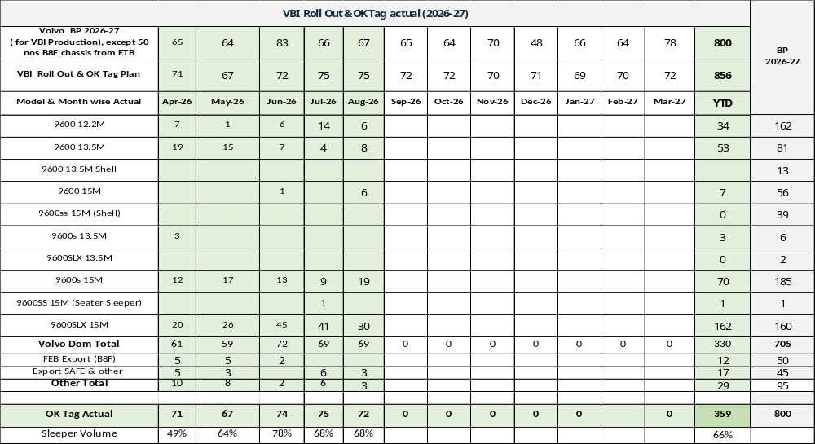

Slide 31
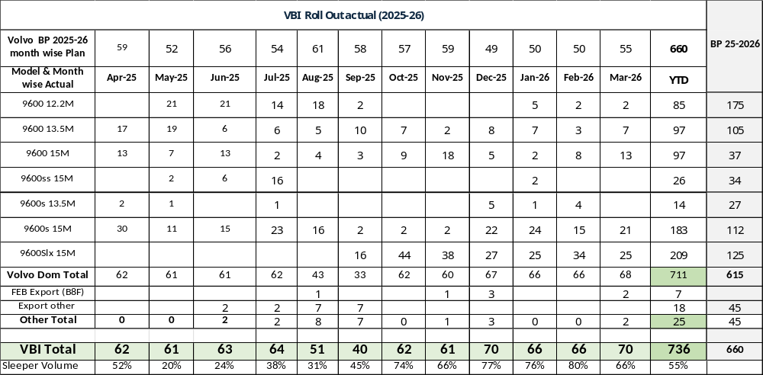

Slide 32
Imports Status – WK2636
Import Summary as on 31.08 |  | Part Critical in Days
Import Part | Total Parts | 90 Above | 60-90 D | 45-60 D | 30-45 D | 15-30 D | 0-15 D | Remarks
REGULAR | 114 | 77 | 31 | 1 | 2 | 3 | 0
PRO8000 | 70 | 46 | 22 | 1 | 1 | 0 | 0
PRO8055/6055 | 11 | 5 | 6 | 0 | 0 | 0 | 0
PRO8055 | 14 | 11 | 0 | 0 | 3 | 0 | 0
Total Parts | 209 | 139 | 59 | 2 | 6 | 3 | 0
Cumulative |  | 139 | 198 | 200 | 206 | 209 | 209
Under 30 Days Parts Update:
1) Sanden Thailand – PN IH000951 AC Compressor: Aug Production covered, Short for Aftermarket as their demand has been increased in June-Jul (By 150 Nos). 200 SEA ETA 03rd Sep+ 200 ETA 20th Sep+ 200 ETA 30th Sep.
Critical Parts:
1) MITSUBISHI EUROPE – PN ID339812 EGR Valve E694: Current Stock 322 Covered next two Month as per Forecast, However this forecast always increased. Hence Sensing Risk for Oct production, next pickup from Supplier Expected in Mid of Nov.
3) TMBP – PN 82626303 Pedal Arm: Current Stock 139 Covered till 30th Sep. Part under localization, need support from resp. department.(Import Supplier Denied for Supply)

Slide 33
Parts Coverage Details
 |  |  |  |  | 30 Days Req |  | 30-60 Days Req
S.NO. | Vendor Name | PART NO | PART DESCRIPTION | BOM | Prod. | VEPDC | Prod | VEPDC | Total | 31.08 stock | Short for 60 days | Day Coverage | Mitigation Plan | Coverage After Mitigation | Target >90 days
1 | SANDEN | IH000951 | AC COMPRESSOR | 1 | 52 | 250 | 133 | 250 | 685 | 251 | -434 | 15-30 | 200 ETA 03.09 200 ETA 20.09 200 ETA 30.09 | With 200 >> upto 14.09 with 200 >> up to 04.10 with 200>> up to 60 days | Oct WK 3
2 | VITESCO | IE302842 | CONTROL UNIT | 1 | 128 | 9 | 66 | 9 | 213 | 76 | -137 | 15-30 | 96 pickup 07.09 ETA 15.09 192 ETA 20.09 | With 96 >> upto 18.10 With 192 >> above 60 days | Oct WK 2
3 | Yazaki Europe | IE302849 | VECU 12V | 1 | 55 | 16 | 20 | 16 | 106 | 44 | -62 | 15-30 | 64 pickup 03.09 ETA 20.09 32 ETA 25.10 | With 64 >> up to 30.10 With 32 >> above 60 days | Oct WK 3
4 | NOK ASIA | ME074696 | SEAL | 8 | 4752 | 11406 | 4124 | 11406 | 31687 | 21750 | -9937 | 30-45 | 18000 ETA 20.09 | With 18000 >> upto 60 Days | Sep WK 4
5 | JTEKT | ME013384 | OIL SEAL | 1 | 4956 | 5120 | 5194 | 5120 | 20390 | 11965 | -8425 | 30-45 | 3840 pickup 10.09 ETA 20.09 5760 pickup 12.09 ETA 12.10 | With 3840 >> upto 16.10 with 5760 >> above 60 Days | Oct WK 2
6 | Yazaki Europe | IE302735 | VECU 24VDC | 1 | 62 | 120 | 70 | 120 | 373 | 321 | -52 | 45-60 | 110 pickup 03.09 ETA 20.09 110 ETA 25.10 220 ETA 15.11 | With 110 >> up to 60 Days With 110 >> above 90 Days With 64 >> above 90 days | Oct WK 3
7 | TMBP | 82626303 | PEDAL ARM | 1 | 85 | 1 | 105 | 1 | 192 | 139 | -53 | 30-45 | TMBP denied to Supply
8 | TMBP | 82505814 | WIPER ARM | 2 | 210 | 80 | 210 | 80 | 580 | 553 | -27 | 45-60 | 1121 pickup 16.09 ETA 25.09 | With 1121 above 90 days | Sep WK 4
9 | Norgren | ID802327 | SOLENOID VALVE | 2 | 40 | 3 | 50 | 3 | 96 | 60 | -36 | 30-45 | 120 ETA 04.09 108 ETA 25.10 | with 120 >> up to 60 Days With 108 >> up to 90 Days | Sep WK 4
10 | Tianjin | IA800089 | BRACKET KIT | 1 | 20 | 0 | 25 | 0 | 45 | 30 | -15 | 30-45 | 30 ETA 04.09 | with 30 >> upto 90 Days | Sep WK 4
11 | Tianjin | IA800099 | BRACKET KIT | 1 | 20 | 0 | 25 | 0 | 45 | 31 | -14 | 30-45 | 30 ETA 04.09 | with 30 >> upto 90 Days | Sep WK 4
PRO8055 | PRO8000 | PRO8055/6055 | Regular

Slide 34
Thank You

Slide 35
Shift Planning – FY’27
Rollout & Distribution Planning FY'27
Sales Volumes | Model | Apr-26 | May-26 | Jun-26 | Jul-26 | Aug-26 | Sep-26 | Oct-26 | Nov-26 | Dec-26 | Jan-27 | Feb-27 | Mar-27 | FY'27
 | LMD (Bhopal) | 3465 | 3686 | 3721 | 3978 | 3858 | 3968 | 4081 | 3831 | 4169 | 4623 | 4553 | 5120 | 49053
 | HD (Pithampur) | 1257 | 1336 | 1466 | 1486 | 1460 | 1554 | 1711 | 1780 | 1930 | 2042 | 2158 | 2321 | 20501
 | MHD (Pithampur) | 2391 | 2557 | 2623 | 2486 | 2191 | 2169 | 2293 | 2179 | 2700 | 2919 | 3071 | 3537 | 31116
 | Grand Total | 7113 | 7579 | 7810 | 7950 | 7509 | 7691 | 8085 | 7790 | 8799 | 9584 | 9782 | 10978 | 100670
Working Days |  | 23 | 26 | 26 | 27 | 24 | 25 | 25 | 22 | 27 | 25 | 24 | 26 | 300
D
Installed Capacity / Shift | LMD Line (Bhopal) | 70 | 70 | 70 | 70 | 70 | 70 | 70 | 70 | 70 | 70 | 70 | 70
 | MHD Line (Pithampur) | 70 | 70 | 70 | 70 | 70 | 70 | 70 | 70 | 70 | 70 | 70 | 70
 | HD Line (Pithampur) | 45 | 45 | 45 | 45 | 45 | 45 | 45 | 45 | 45 | 45 | 45 | 45
Capacity Utilization | LMD Line (Bhopal) | 80% | 80% | 80% | 80% | 80% | 80% | 80% | 80% | 80% | 83% | 83% | 83%
 | MHD Line (Pithampur) | 80% | 80% | 80% | 80% | 80% | 80% | 80% | 80% | 80% | 83% | 83% | 83%
 | HD Line (Pithampur) | 80% | 80% | 80% | 80% | 80% | 80% | 80% | 80% | 80% | 80% | 80% | 80%
Shift Plan | LMD Line (Bhopal) | 3 | 3 | 3 | 3 | 3 | 3 | 3 | 3 | 3 | 3 | 3 | 3
 | MHD Line (Pithampur) | 2 | 2 | 2 | 2 | 2 | 2 | 2 | 2 | 2 | 3 | 3 | 3
 | HD Line (Pithampur) | 2 | 2 | 2 | 2 | 2 | 2 | 2 | 2 | 2 | 3 | 3 | 3
Rollout Distribution | LMD Line (Bhopal) | 3635 | 4109 | 4109 | 4267 | 3793 | 3951 | 3951 | 3477 | 4267 | 4099 | 3935 | 4263 | 47858
 | MHD Line (Pithampur) | 2576 | 2912 | 2912 | 3024 | 2688 | 2800 | 2800 | 2464 | 3024 | 4099 | 3935 | 4263 | 37498
 | HD Line (Pithampur) | 1656 | 1872 | 1872 | 1944 | 1728 | 1800 | 1800 | 1584 | 1944 | 2540 | 2438 | 2642 | 23820
 | Total | 7867 | 8893 | 8893 | 9235 | 8209 | 8551 | 8551 | 7525 | 9235 | 10739 | 10309 | 11168 | 109176
Shortfall / Excess | Total | 754 | 1314 | 1083 | 1285 | 700 | 860 | 466 | -265 | 436 | 1155 | 527 | 190 | 8506
3-Days Inventory considered in April' 2026
Pro 2000 cabins will produce at Bhopal & Pro 2000 cowls will produce at Pithampur (However, complete flexibility inbuilt at both the plants for Pro 2000 cabins & cowls)
To balance & optimize amongst MHD & HD lines, Pro 3019 model is flexible

